Slide 1
Quality, Cost and Time Management
- Vaishnavi Viswanathan

Slide 2
Project Management
Managing a project includes managing Resources, Scope, Time, Cost, Quality and Risk throughout the Software Development Life Cycle Process
Project managers should learn to
Master managing a project with all the above discussed aspects while leading a project to make it successful
Master soft skills and leadership skills to deal with non-technical problems that are inevitable in any project
To build a good network and reputation in an organization and build trust with co workers and team members
In recent years since majority of the organizations are shifting to agile development changing requirements in projects are inevitable
Notes:
Why do we need project management?
Why I chose this topic?

Slide 3
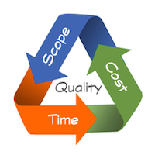
Triple constraint – Scope, Time and Cost
In project management, it is important to manage the triple constraints – scope, time and cost right from project plan initiation
Cost, time and scope are called the triple constraints and are represented in the form of a triangle (iron triangle) with the Quality positioned in the middle.
Balancing these three is what is the challenge to make the product successful at the end.
Source

Slide 4
Triple constraint – Scope, Time and Cost
SCOPE – They are requirements of the final product to be delivered
TIME – It is the total time taken to deliver the product to the clients
COST – It is the total budget provided to the company for developing the product
Changing one among the three constraints will definitely affect the other two constraints in one form or the other which will eventually affect the quality of the product
Quality of the project might get compromised especially with changing requirements
Managing the built product without compromising the Quality of it with Cost and Time constraints is an excellent skill that is required to keep the production going with customer satisfaction

Slide 5
How to manage scope, time and cost?
We can manage them by
Understanding
During project initialization the scope should be well understood
Budget and Scheduling must be done in regards with the scope in hand
Knowing the fact that changing or adding requirements (scope) to the project will affect the other constraints
Communicating
Discussions regarding changing scopes and how it might affect the other constraints should be discussed with the stakeholders while initializing the project

Slide 6
How to manage scope, time and cost?
These discussions help in having all the stakeholders in the same page
Requests from clients to include extravagant changes to the project with out an increase in budget or time can be avoided when results affecting the triple constraints when including new changes are discussed upfront during project initialization
3. Monitoring
Once the project is initialized and is in production, constant check to maintain the triple constraint is essential to make the project a success
Being aware that changing any one constraint would have an impact in the other two constraints
Monitoring and requesting clients to be flexible in changing the rest of the constraints with new changes in scope

Slide 7
Why Quality Management?
Quality of a product is important since it marks the standard for a company
Most often products get ranked by their Quality in the market
If the product comes from a branded company, people are more likely to buy it because of their assurance that the product released from a selected branded company would meet their expectations and would be of good standards
Once a company establishes its brand in the market, people tend to trust the company and buy products that the company releases
Hence, Quality helps a company set its standard in the market and managing it is very important

Slide 8
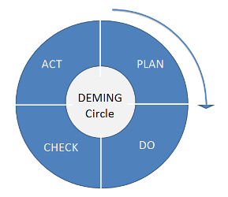
Source Plan-Do-Check-Act (Deming Cycle)
Quality Management Process
Quality Management most often includes following the Deming Cycle for showing continuous improvement in quality of a project
The Deming Cycle involves four sequential steps
Plan – when there is a change a plan is made to address the change
Do – tests are done for the change addressed
Check – tests done above are reviewed and identified
Act – action is taken according to what was learnt
If the plan fails, a new plan is created and the Deming cycle is repeated.

Slide 9
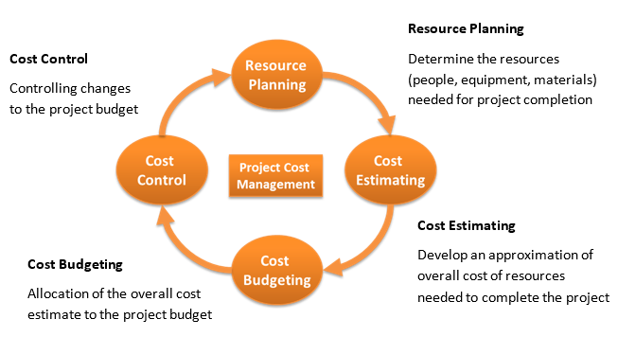
Cost Management
Source

Slide 10
Cost Management Process
Proper handling of budget is always important when leading a project
Cost management usually involves four steps
Planning
Estimation
Budgeting and
Control
Planning –
During project initialization, a work breakdown structure is followed and all the resources required are noted down that affects the cost for a project
Some of the resources being – labor, physical equipment etc.

Slide 11
Cost Management Process
Estimation –
Cost estimation is the most important step in cost management process
There are a lot of cost estimation tools and techniques which will be chosen with respect to the project
Some include looking at the documented cost estimates from previous project to give an idea to estimate budget for the current project Ex: Top-Down Approach
Some include mathematical computations that helps give a clear picture of how the project’s cost estimation is going to be in much deeper level Ex: Parametric Approach

Slide 12
Cost Management Process
Budgeting –
Costs are assigned to each activity throughout the project development time line as and when the costs get incurred
Control –
Cost baseline – It is the cost approved for a particular activity that is timed
Cost baseline is often used to monitor the progress of the project
Cost is controlled for each sub task by continuously monitoring the expenditure with regards to the cost baseline so that the project does not go out of budget

Slide 13
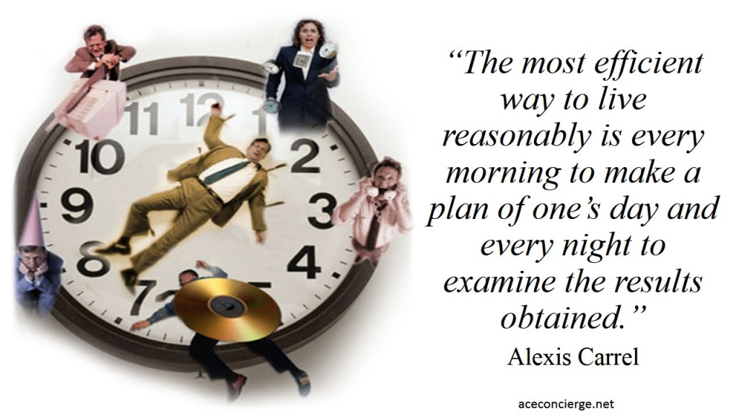
Time Management
Source

Slide 14
Time Management Techniques
Time - It is the total time taken to deliver the project to client
Managing schedules in project development is important to deliver products on time
Delivering products on time will
Increase the bond and trust between clients and the organization
Builds reputation of the organization that will attract more clients to the organization
Throughout the product development process there might be some unexpected situations that might arise that might affect the schedule of the project.
Hence, in situations like this it is important for the manager to always have a contingency plan.

Slide 15

Time Management Techniques
Each project manager has some shortcomings with respect to manage schedules. Some of the areas a manager should look into are
Assigning tasks to team members
Taking decisions on feet
Choosing appropriate meetings to attend
Learning to prioritize tasks
Trying to satisfy everyone by providing help
Learning to avoid unwanted travels
Slacking
Source

Slide 16
Cost & Time Estimation Tools
Some of the estimating tools and techniques are
Top-Down Estimation –
Cost estimates are done with previously completed projects and an expert judgement is made to take decisions on the cost estimate
Not accurate enough
Parametric Estimation –
Cost estimates are done using both historical data as well as statistical data
Ex: Total cost for a particular material used in previous project is analyzed along with the total amount used
Analyzed results are used for the current project

Slide 17
Cost & Time Estimation Tools
Three point estimates –
Three cost estimates are done and an average between all three of them is made
Usually the three cost estimates include a normal case, worst case and an best case scenario.
Bottom-Up Estimation –
Deals with work breakdown structure and cost estimates are done for each breakdown structure with greater level of detail
Cost estimates per breakdown structure is summed up to get the final budget cost estimate
Expensive approach yet accurate
Top-Down is the least accurate and the Bottom-Up is the most accurate.

Slide 18

Source

Slide 19

CASE STUDY I
Interviewed the Founder of 3DC Designs,
2014, Hyderabad, India
What does the company do?
Art – Designing (Start –up) : Wall Murals, Canvas art, Graphic designing, and Logo designing
Source

Slide 20
What did I learn?
Being a start up, it is important to first build reputation by prioritizing the client requirement and satisfaction
Balancing the Quality with Cost and Time by using already procured materials and left overs from previous projects in uncertain situations when the final product does not meet client’s satisfaction instead of requesting for more budget from client
Choosing the right team workers for the right project
Should be talented, passionate as well as know how to exhibit their talent when working with other team members
Should be good at marketing
Have a strong personality and a positive outlook to things, confident
Trust worthy, transparent, honest to avoid conflicts

Slide 21
Always having a contingency plan ready for uncertain situations
Example:
For a voluntary project since it is a non-profit work and there is no budget involved, the individuals volunteering for such kind of work will keep decreasing day by day
Need to have a contingency plan devised for uncertain situation like volunteers dropping out and know how to split the work among the volunteers present in the team

Slide 22
Handling team dynamics
Trust your team workers
Delegate work to them and wait for results
Actively listening and giving weightage to what suggestions the team has
Actively communicating problems and being transparent with team mates
Contingency plan should be well in advance planned to avoid time and cost overruns
Look out for the Quality of the product right from the project initialization

Slide 23

CASE STUDY II
Interviewed the Operation Coordinator
of Larsen & Toubro, Bangalore, India
What does the company do?
Power transmission and Distribution
Industry:
Remote construction of transmission towers
Source

Slide 24

Regional Office
Operation Coordinator
Project Office
Project Office
Project Office
Execution teams with Team lead
Supervisors
(Entry level Engineers)
Project Manager
Accounts Manager
Project Manager
Project Manager
Accounts Manager
Accounts Manager
Planning Engineer
Planning Engineer
Planning Engineer

Slide 25
What did I learn?
Management work differs in each industry
A project for example in construction has a hierarchical structure in which each sub team in different Project Office locations will manage a sub task for the entire project
The requirements from the planning engineers are put forward for approval to the Project Manager and Accountant Manager which in turn goes to the Operation Coordinator for final approval
Safety concerns – In construction site safety measures has to be taken for each employee
Scheduled meetings with each manager from different remote site locations is done by the coordinator to make sure the groups have all they want to make progress in the project in the execution level and helping them clear out any blockers
The planning managers are responsible to make sure the supervisors work well to manage the construction site employees
Travelling and relocating to remote areas might be required depending on the project especially in construction related projects

Slide 26
- Fore seeing events and planning things way ahead in time is required on a higher level so that the each sub tasks depending on each other does not get affected
For example:
In construction work, if the suppliers delay the delivery, contractors cannot hire employees to work on the construction site until the products come in. If the contractors are idle, the company will be losing money for paying them for their idle work since it the company to get blamed at for not providing resources and not the contractors. Thus, the entire pipeline will get affected if one task gets disturbed
One way to handle the above situation is by planning way ahead and requesting the resources from the suppliers 2 weeks well in advance

Slide 27
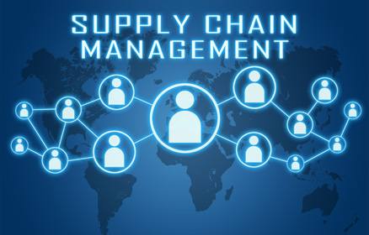
CASE STUDY III
Interviewed the Manager in Supply chain management of Rockwell Automation, Wisconsin, United states of America
What does the company do?
Warehouse, Logistics and Sourcing
All those information that was hand typed by the individual interviewed are written in quotes.
Source

Slide 28
Setbacks are quite often when leading a project. The manager said we should “stay positive, take a step back, evaluate alternative solutions to still be able to complete the project as per the schedule and communicate to the project sponsors”
When uncertain situations arise that makes the project to delay and if the clients are convinced to increase the deadline dates, we should make sure to create an extensive plan to give more than what they expect with the resources and budget provided so that it satisfies the customer
“Always identify and communicate with individuals to know the tribal knowledge about the process that is not documented”

Slide 29
Cultivate non-technical skills to be a people’s person on top of mastering the technical skills
Always recruit individuals who posses “qualities to step out of their comfort zone to develop new skills, inspire and handle resistance and trainings well”
“Always the goals, roles and responsibilities of each member has to be communicated clearly to the entire team and their corresponding managers/supervisors when executing the project to avoid conflicts
Any blockers in implementing the requirements should be addressed quickly through feedbacks to prevent the project from going at loss

Slide 30
Managers ought to create “an environment where people freely express their ideas and concerns while ensuring decisions are made timely. It rarely happens that everyone agrees with everything. Therefore, it is important to ensure that the members commit to the plan once a decision is made as a team even though they might not agree completely”
“The success or failure of a project depends on:
1. Planning: More time should be spent on understanding the business needs, assessing risks and planning. When this is done, the actual execution part will be easy and smooth
2. People: People have the ability to make break a project. As a leader/manager, it is important for you to make sure people are motivated, driven and have a positive mindset”

Slide 31
Conclusion
Project management is always situation based
Learning to think on your feet and always foreseeing events and planning them ahead
Not all situations can be handled just by understanding case studies
Each individual learn to handle adverse unexpected situations over the course of time and experience
Management is a day to day process
There can never be set backs in the last week of the project – instead set backs occur each and ever day that has to be handled and managed so that the project does not fail
Hence managing Cost, Time and Quality (triple constraints) can be done with proper planning by fore seeing events and appropriately taking actions with the discussed skills above

Slide 32
References
https://www.slideshare.net/chetanchawla16/apple-quality-policy
http://www.thinkforachange.com/blog/sdlcisnotapmmethodology/
http://www.testingexcellence.com/software-development-life-cycle-sdlc-phases/
https://en.wikipedia.org/wiki/Systems_development_life_cycle
https://www.pmi.org/about/learn-about-pmi/what-is-project-management
http://www.projectinsight.net/project-management-basics/basic-project-management-phases
http://www.brighthubpm.com/methods-strategies/75326-pdca-for-quality-management/
https://www.projectsmart.co.uk/understanding-the-project-management-triple-constraint.php
http://whatis.techtarget.com/definition/triple-constraint
https://programsuccess.wordpress.com/2011/05/02/scope-time-and-cost-managing-the-triple-constraint/
https://programsuccess.wordpress.com/2013/01/01/effective-time-management-for-the-project-manager/
http://www.project-management-skills.com/project-cost-management.html
https://programsuccess.wordpress.com/2011/05/03/ensuring-project-quality-key-ideas/
http://lafavesconstruction.com/wp-content/uploads/2015/05/construction-management.jpg

Slide 33
References
http://asq.org/learn-about-quality/project-planning-tools/overview/pdca-cycle.html
http://whatis.techtarget.com/definition/PDCA-plan-do-check-act
http://asq.org/learn-about-quality/project-planning-tools/overview/pdca-cycle.html
https://tensix.com/wp-content/uploads/2014/08/Management-and-the-Triple-Constraints.png
https://www.sajan.com/cost-and-turnaround-time-affect-quality-translations/
https://www.sajan.com/translation-quality-speedy-turnaround-can/
https://www.sajan.com/fridaylocfaq-can-you-skip-translation-review-with-proper-context/
http://www.costmanagement.eu/blog-article/198-cost-management-explained-in-4-steps
https://www.simplilearn.com/estimation-tools-and-techniques-part-i-article
https://pmstudycircle.com/2012/06/4-tools-to-estimate-costs-in-the-project-management/
https://www.mindtools.com/pages/article/newPPM_01.htm

Slide 34
References
http://www.costmanagement.eu/images/blog/Cost-management-cycle.PNG
http://stepsnew.nadsoft.co/Public//image/1Time.jpg
http://aceconcierge.net/wp-content/uploads/2014/01/Time-Management-1024x576.jpg
https://www.ipsos-retailperformance.com/wp-content/uploads/2014/10/case-studies-e1418894555587.jpg
https://s-media-cache-ak0.pinimg.com/736x/2e/9b/99/2e9b99119d885f4ebd137ce76dbd0e2a.jpg
https://image.shutterstock.com/z/stock-photo-well-dressed-man-in-suit-and-tie-charismatic-businessman-standing-on-white-background-180048572.jpg
http://www.coaconsult.com/ccp/wp-content/uploads/2015/05/supply-chain-management.jpg

Slide 35
Case Studies
-------------------------------------------------------------------------------------------------
With credits and special thanks
Lavanya Tamarapalli, Sekhar Rajasekharam Attaluri
and Ashwin Sridhar
Thank you! ☺

